Slide 1
HTML5

Slide 2
Content
Semantic Elements
Control Elements
Semantic Elements

Slide 3
HTML Semantic Elements
Semantic Elements – Element with meaning
A semantic element clearly describes its meaning to both the browser and the developer.
Examples of non-semantic elements: <div> and <span> - Tells nothing about its content.
Examples of semantic elements: <form>, <table>, and <article> - Clearly defines its content.
Many web sites contain HTML code like:
<div id="nav"> <div class="header"> <div id="footer">
to indicate navigation, header, and footer.
In HTML there are some semantic elements that can be used to define different parts of a web page

Slide 4
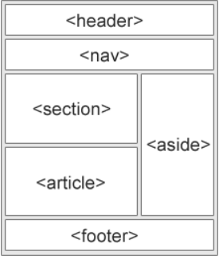
HTML Semantic Elements
A semantic Web allows data to be shared and reused across applications, enterprises, and communities.
Some of the examples:
Tag Description
<article> Defines independent, self-contained content
<aside> Defines content aside from the page content
<details> Defines additional details that the user can view or hide
<figcaption> Defines a caption for a <figure> element
<figure> Specifies self-contained content, like illustrations, diagrams, photos, code
<footer> Defines a footer for a document or section
<header> Specifies a header for a document or section
<main> Specifies the main content of a document
<mark> Defines marked/highlighted text
<nav> Defines navigation links
<section> Defines a section in a document
<summary> Defines a visible heading for a <details> element
<time> Defines a date/time

Slide 5
HTML Semantic Element
<!DOCTYPE html> <html lang = "en-US"> <head> <title>Images</title> </head> <body>
<section> <h1>WWF</h1> <p>The World Wide Fund for Nature (WWF) is an international organization working on issues regarding the conservation, research and restoration of the environment, formerly named the World Wildlife Fund. WWF was founded in 1961.</p> </section> <section> <h1>WWF's Panda symbol</h1> <p>The Panda has become the symbol of WWF. The well-known panda logo of WWF originated from a panda named Chi Chi that was transferred from the Beijing Zoo to the London Zoo in the same year of the establishment of WWF.</p> </section>
</body>
</html>
HTML <section> Element
The <section> element defines a section in a document.
"A section is a thematic grouping of content, typically with a heading."
A web page could normally be split into sections for introduction, content, and contact information.
Example:
Two sections in a document

Slide 6
HTML Semantic Element
HTML <article> Element
The <article> element specifies independent, self-contained content.
An article should make sense on its own, and it should be possible to distribute it independently from the rest of the web site.
Examples of where an <article> element can be used:
Forum post
Blog post
Newspaper article
Example:
Three articles with independent, self-contained content:
<!DOCTYPE html> <html lang = "en-US"> <head> <title>Images</title> </head> <body>
<article> <h2>Google Chrome</h2> <p>Google Chrome is a web browser developed by Google, released in 2008. Chrome is the world's most popular web browser today!</p> </article> <article> <h2>Mozilla Firefox</h2> <p>Mozilla Firefox is an open-source web browser developed by Mozilla. Firefox has been the second most popular web browser since January, 2018.</p> </article> <article> <h2>Microsoft Edge</h2> <p>Microsoft Edge is a web browser developed by Microsoft, released in 2015. Microsoft Edge replaced Internet Explorer.</p> </article>
</body>
</html>

Slide 7
HTML Semantic Element
<!DOCTYPE html> <html lang = "en-US"> <head> <title>Images</title> </head> <body>
<article> <h2>Google Chrome</h2> <p>Google Chrome is a web browser developed by Google, released in 2008. Chrome is the world's most popular web browser today!</p> </article> <article> <h2>Mozilla Firefox</h2> <p>Mozilla Firefox is an open-source web browser developed by Mozilla. Firefox has been the second most popular web browser since January, 2018.</p> </article> <article> <h2>Microsoft Edge</h2> <p>Microsoft Edge is a web browser developed by Microsoft, released in 2015. Microsoft Edge replaced Internet Explorer.</p> </article>
</body>
</html>
HTML <article> Element
The <article> element specifies independent, self-contained content.
The <section> element defines section in a document.
We can’t use the definitions to decide how to nest those elements
So, we can find HTML pages with <section> elements containing <article> elements, and <article> elements containing <section> elements.

Slide 8
HTML Semantic Element
<!DOCTYPE html> <html lang = "en-US"> <head> <title>Images</title> </head> <body>
<article> <header> <h1>What Does WWF Do?</h1> <p>WWF's mission:</p> </header> <p>WWF's mission is to stop the degradation of our planet's natural environment, and build a future in which humans live in harmony with nature.</p> </article>
</body>
</html>
HTML <header> Element
The <header> element represents a container for introductory content or a set of navigational links.
A <header> element typically contains:
one or more heading elements (<h1> - <h6>)
logo or icon
authorship information
We can have several <header> elements in one HTML document.
<header> cannot be placed within a <footer>, <address> or another <header> element.

Slide 9
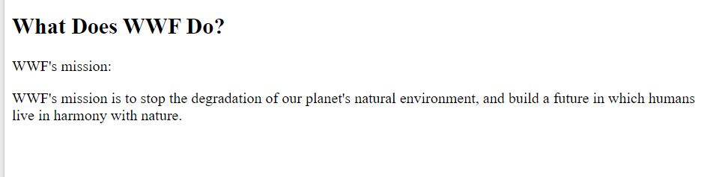
HTML Semantic Element
<!DOCTYPE html> <html lang = "en-US"> <head> <title>Images</title> </head> <body>
<article> <header> <h1>What Does WWF Do?</h1> <p>WWF's mission:</p> </header> <p>WWF's mission is to stop the degradation of our planet's natural environment, and build a future in which humans live in harmony with nature.</p> </article>
</body>
</html>

Slide 10
HTML Semantic Element
HTML <footer> Element
The <footer> element defines a footer for a document or section.
A <footer> element typically contains:
authorship information
copyright information
contact information
sitemap
back to top links
related documents
We can have several <footer> elements in one document.
<!DOCTYPE html> <html lang = "en-US"> <head> <title>Images</title> </head> <body>
<article> <header> <h1>What Does WWF Do?</h1> <p>WWF's mission:</p> </header> <p>WWF's mission is to stop the degradation of our planet's natural environment, and build a future in which humans live in harmony with nature.</p> </article>
<footer> <p>Author: Hege Refsnes</p> <p><a href="mailto:hege@example.com">hege@example.com</a></p> </footer>
</body>
</html>

Slide 11
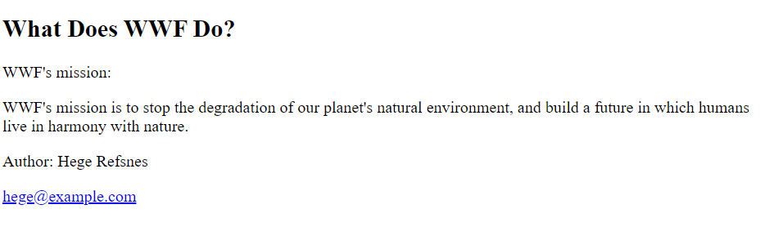
HTML Semantic Element
<!DOCTYPE html> <html lang = "en-US"> <head> <title>Images</title> </head> <body>
<article> <header> <h1>What Does WWF Do?</h1> <p>WWF's mission:</p> </header> <p>WWF's mission is to stop the degradation of our planet's natural environment, and build a future in which humans live in harmony with nature.</p> </article>
<footer> <p>Author: Hege Refsnes</p> <p><a href="mailto:hege@example.com">hege@example.com</a></p> </footer>
</body>
</html>

Slide 12
HTML Semantic Element
<!DOCTYPE html> <html lang = "en-US"> <head> <title>Images</title> </head> <body>
<nav> <a href="/html/">HTML</a> | <a href="/css/">CSS</a> | <a href="/js/">JavaScript</a> | <a href="/jquery/">jQuery</a> </nav>
<article> <header> <h1>What Does WWF Do?</h1> <p>WWF's mission:</p> </header> <p>WWF's mission is to stop the degradation of our planet's natural environment, and build a future in which humans live in harmony with nature.</p> </article>
<footer> <p>Author: Hege Refsnes</p> <p><a href="mailto:hege@example.com">hege@example.com</a></p> </footer>
</body>
</html>
HTML <nav> Element
The <nav> element defines a set of navigation links.
Notice that NOT all links of a document should be inside a <nav> element.
The <nav> element is intended only for major block of navigation links.

Slide 13
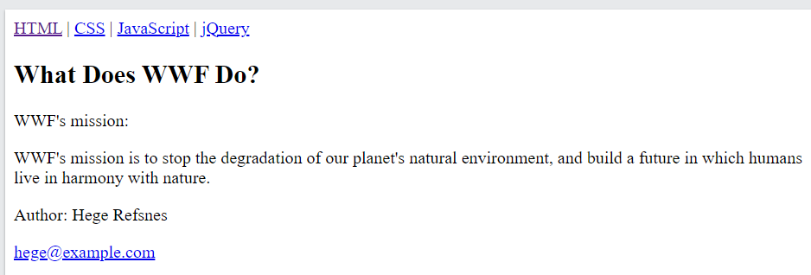
HTML Semantic Element
<!DOCTYPE html> <html lang = "en-US"> <head> <title>Images</title> </head> <body>
<nav> <a href="/html/">HTML</a> | <a href="/css/">CSS</a> | <a href="/js/">JavaScript</a> | <a href="/jquery/">jQuery</a> </nav>
<article> <header> <h1>What Does WWF Do?</h1> <p>WWF's mission:</p> </header> <p>WWF's mission is to stop the degradation of our planet's natural environment, and build a future in which humans live in harmony with nature.</p> </article>
<footer> <p>Author: Hege Refsnes</p> <p><a href="mailto:hege@example.com">hege@example.com</a></p> </footer>
</body>
</html>

Slide 14
HTML Semantic Element
<html> <head> <style> aside { width: 30%; padding-left: 15px; margin-left: 15px; float: right; font-style: italic; background-color: lightgray; } </style> </head> <body> <p>My family and I visited The Epcot center this summer. The weather was nice, and Epcot was amazing! I had a great summer together with my family!</p> <aside> <p>The Epcot center is a theme park at Walt Disney World Resort featuring exciting attractions, international pavilions, award-winning fireworks and seasonal special events.</p> </aside> <p>My family and I visited The Epcot center this summer. The weather was nice, and Epcot was amazing! I had a great summer together with my family!</p>
</body>
</html>
HTML <aside> Element
The <aside> element defines some content aside from the content it is placed in (like a sidebar).
The <aside> content should be indirectly related to the surrounding content.

Slide 15
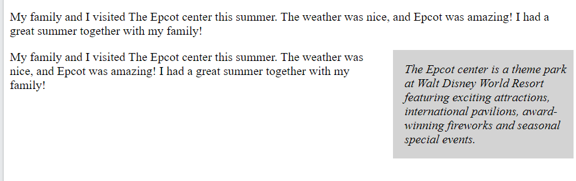
HTML Semantic Element
<html> <head> <style> aside { width: 30%; padding-left: 15px; margin-left: 15px; float: right; font-style: italic; background-color: lightgray; } </style> </head> <body> <p>My family and I visited The Epcot center this summer. The weather was nice, and Epcot was amazing! I had a great summer together with my family!</p> <aside> <p>The Epcot center is a theme park at Walt Disney World Resort featuring exciting attractions, international pavilions, award-winning fireworks and seasonal special events.</p> </aside> <p>My family and I visited The Epcot center this summer. The weather was nice, and Epcot was amazing! I had a great summer together with my family!</p>
</body>
</html>

Slide 16
HTML Semantic Element
<html> <head>
<title>Images</title> </head> <body> <figure> <img src="pic_trulli.jpg" alt="Trulli"> <figcaption>Fig1. - Trulli, Puglia, Italy.</figcaption> </figure>
</body>
</html>
HTML <figure> and <figcaption> Element
The <figure> tag specifies self-contained content, like illustrations, diagrams, photos, code listings, etc.
The <figcaption> tag defines a caption for a <figure> element.
The <figcaption> element can be placed as the first or as the last child of a <figure> element.
The <img> element defines the actual image/illustration.

Slide 17
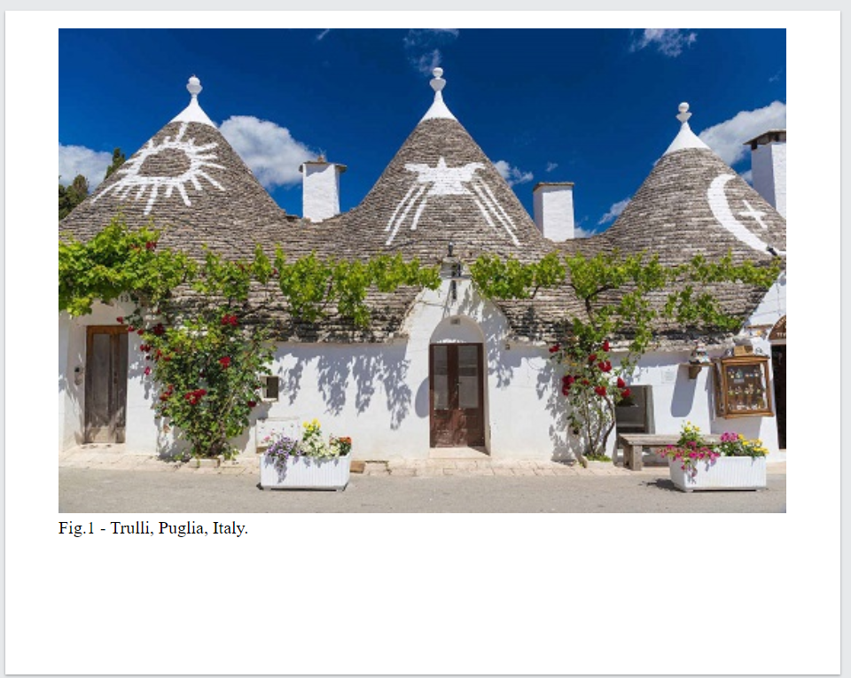
HTML Semantic Element
<html> <head>
<title>Images</title> </head> <body> <figure> <img src="pic_trulli.jpg" alt="Trulli"> <figcaption>Fig1. - Trulli, Puglia, Italy.</figcaption> </figure>
</body>
</html>

Slide 19
HTML Audio
The HTML <audio> element is used to play an audio file on a web page.
The controls attribute adds audio controls, like play, pause, and volume.
The <source> element allows you to specify alternative audio files which the browser may choose from.
The browser will use the first recognized format.
The text between the <audio> and </audio> tags will only be displayed in browsers that do not support the <audio> element.
To start an audio file automatically, use the autoplay attribute
Add muted after autoplay to let your audio file start playing automatically (but muted)
<!DOCTYPE html> <html lang = "en-US"> <head> <title>Images</title> </head> <body>
<audio controls autoplay muted> <source src="horse.ogg" type="audio/ogg"> <source src="horse.mp3" type="audio/mpeg"> Your browser does not support the audio element. </audio>
</body>
</html>

Slide 20
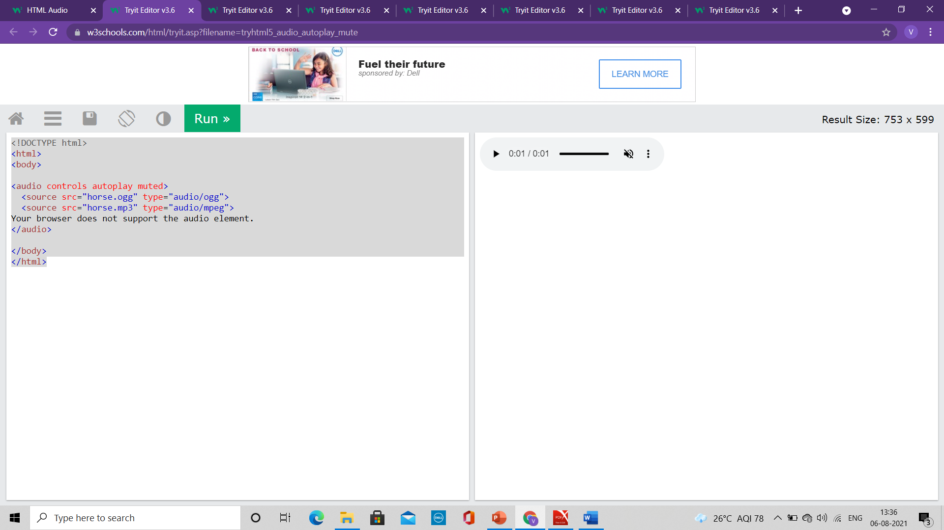
HTML Audio
<!DOCTYPE html> <html lang = "en-US"> <head> <title>Images</title> </head> <body>
<audio controls autoplay muted> <source src="horse.ogg" type="audio/ogg"> <source src="horse.mp3" type="audio/mpeg"> Your browser does not support the audio element. </audio>
</body>
</html>

Slide 21
HTML Audio
<!DOCTYPE html> <html lang = "en-US"> <head> <title>Images</title> </head> <body>
<audio controls autoplay muted> <source src="horse.ogg" type="audio/ogg"> <source src="horse.mp3" type="audio/mpeg"> Your browser does not support the audio element. </audio>
</body>
</html>
HTML Audio - Media Types
File Format Media Type
MP3 audio/mpeg
OGG audio/ogg
WAV audio/wav

Slide 22
HTML Video
The HTML <video> element is used to show a video on a web page.
The controls attribute adds video controls, like play, pause, and volume.
It is a good idea to always include width and height attributes.
If height and width are not set, the page might flicker while the video loads.
The <source> element allows you to specify alternative video files which the browser may choose from.
The browser will use the first recognized format.
The text between the <video> and </video> tags will only be displayed in browsers that do not support the <video> element.
Add muted after autoplay to let your video start playing automatically (but muted)
<!DOCTYPE html> <html lang = "en-US"> <head> <title>Images</title> </head> <body>
<video width="320" height="240" autoplay muted> <source src="movie.mp4" type="video/mp4"> <source src="movie.ogg" type="video/ogg"> Your browser does not support the video tag. </video>
</body>
</html>

Slide 23
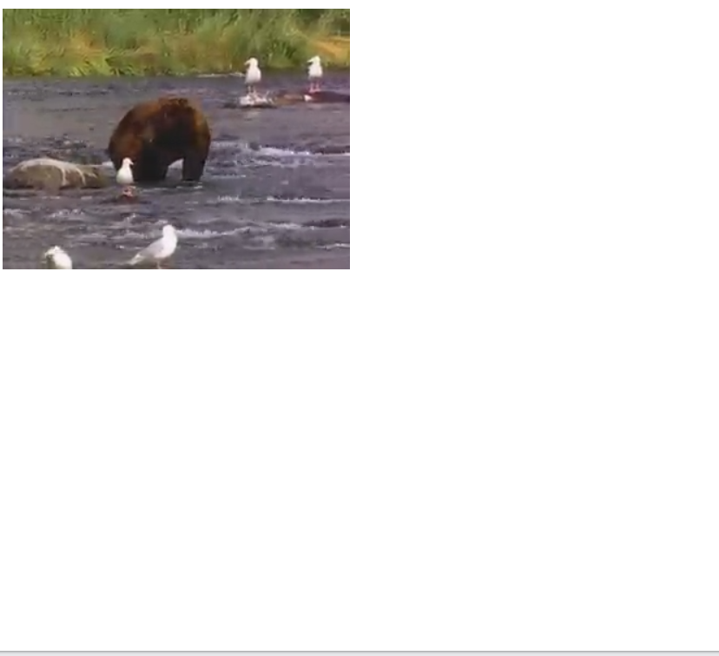
HTML Video
<!DOCTYPE html> <html lang = "en-US"> <head> <title>Images</title> </head> <body>
<video width="320" height="240" autoplay muted> <source src="movie.mp4" type="video/mp4"> <source src="movie.ogg" type="video/ogg"> Your browser does not support the video tag. </video>
</body>
</html>

Slide 24
HTML Video
<!DOCTYPE html> <html lang = "en-US"> <head> <title>Images</title> </head> <body>
<video width="320" height="240" autoplay muted> <source src="movie.mp4" type="video/mp4"> <source src="movie.ogg" type="video/ogg"> Your browser does not support the video tag. </video>
</body>
</html>
HTML Video - Media Types
File Format Media Type
MP4 video/mp4
WebM video/webm
Ogg video/ogg

Slide 25
HTML Video
HTML Video - Methods, Properties, and Events
The HTML DOM defines methods, properties, and events for the <video> element.
This allows you to load, play, and pause videos, as well as setting duration and volume.
There are also DOM events that can notify you when a video begins to play, is paused, etc.

Slide 26
HTML Audio/Video Methods
Method Description
addTextTrack() Adds a new text track to the audio/video
canPlayType() Checks if the browser can play the specified audio/video type
load() Re-loads the audio/video element
play() Starts playing the audio/video
pause() Pauses the currently playing audio/vide

Slide 27
HTML Drag and Drop
In HTML, any element can be dragged and dropped.
Drag and drop is a very common feature.
It is when you "grab" an object and drag it to a different location.

Slide 28
HTML Drag and Drop
<!DOCTYPE HTML> <html> <head> <script> function allowDrop(ev) { ev.preventDefault(); } function drag(ev) { ev.dataTransfer.setData("text", ev.target.id); } function drop(ev) { ev.preventDefault(); var data = ev.dataTransfer.getData("text"); ev.target.appendChild(document.getElementById(data)); } </script> </head> <body> <div id="div1" ondrop="drop(event)" ondragover="allowDrop(event)"></div> <img id="drag1" src="img_logo.gif" draggable="true" ondragstart="drag(event)" width="336" height="69"> </body>
Make an Element Draggable
To make an element draggable, set the draggable attribute to true:
<img draggable="true">
What to Drag - ondragstart and setData()
Specify what should happen when the element is dragged.
In the example, the ondragstart attribute calls a function, drag(event), that specifies what data to be dragged.
The dataTransfer.setData() method sets the data type and the value of the dragged data:
function drag(ev) {
ev.dataTransfer.setData("text", ev.target.id);
}
In this case, the data type is "text" and the value is the id of the draggable element ("drag1").

Slide 29
HTML Drag and Drop
<!DOCTYPE HTML> <html> <head> <script> function allowDrop(ev) { ev.preventDefault(); } function drag(ev) { ev.dataTransfer.setData("text", ev.target.id); } function drop(ev) { ev.preventDefault(); var data = ev.dataTransfer.getData("text"); ev.target.appendChild(document.getElementById(data)); } </script> </head> <body> <div id="div1" ondrop="drop(event)" ondragover="allowDrop(event)"></div> <img id="drag1" src="img_logo.gif" draggable="true" ondragstart="drag(event)" width="336" height="69"> </body>
Where to Drop - ondragover
The ondragover event specifies where the dragged data can be dropped.
By default, data/elements cannot be dropped in other elements.
To allow a drop, we must prevent the default handling of the element.
This is done by calling the event.preventDefault()
method for the ondragover event:
event.preventDefault()

Slide 30
HTML Drag and Drop
<!DOCTYPE HTML> <html> <head> <script> function allowDrop(ev) { ev.preventDefault(); } function drag(ev) { ev.dataTransfer.setData("text", ev.target.id); } function drop(ev) { ev.preventDefault(); var data = ev.dataTransfer.getData("text"); ev.target.appendChild(document.getElementById(data)); } </script> </head> <body> <div id="div1" ondrop="drop(event)" ondragover="allowDrop(event)"></div> <img id="drag1" src="img_logo.gif" draggable="true" ondragstart="drag(event)" width="336" height="69"> </body>
Do the Drop - ondrop
When the dragged data is dropped, a drop event occurs.
In the example above, the ondrop attribute calls a function, drop(event):
function drop(ev) {
ev.preventDefault();
var data = ev.dataTransfer.getData("text");
ev.target.appendChild(document.getElementById(data));
}

Slide 31
HTML Drag and Drop
<!DOCTYPE HTML> <html> <head> <script> function allowDrop(ev) { ev.preventDefault(); } function drag(ev) { ev.dataTransfer.setData("text", ev.target.id); } function drop(ev) { ev.preventDefault(); var data = ev.dataTransfer.getData("text"); ev.target.appendChild(document.getElementById(data)); } </script> </head> <body> <div id="div1" ondrop="drop(event)" ondragover="allowDrop(event)"></div> <img id="drag1" src="img_logo.gif" draggable="true" ondragstart="drag(event)" width="336" height="69"> </body>
Explanation of Code
Call preventDefault() to prevent the browser default handling of the data (default is open as link on drop)
Get the dragged data with the dataTransfer.getData() method. This method will return any data that was set to the same type in the setData() method
The dragged data is the id of the dragged element ("drag1")
Append the dragged element into the drop element

